Slide 1
App modernization
Damir Dobric
Lead Software Architect at daenet GmbH
Microsoft Regional Director
Azure Most Valuable Professional
Proctor:
Edin Mulic
Senior Software Architect at daenet
https://damirdobric.me/

Slide 2
App modernization
Edin Mulic
Senior Software Architect at daenet
Proctor:
Damir Dobric
Lead Software Architect at daenet GmbH
Microsoft Regional Director
Azure Most Valuable Professional
https://damirdobric.me/
Notes:
Sich selbst und daenet kurz vorstellen
MS Partner, sitz in Frankfurt, ca. 15 MA, gegründet Ende 90-ger
Maßgeschneiderte SW Lösungen in MS Umfeld
Sehr viele Cloud Projekte
Neben Modernization Projekten tun wir natürlich die SW Lösungen von Anfang an designen und umsetzen
Neben klassischn Server-Client Anwendungen auch viele System Integration Projekte, IoT aber auch Projekte die in die Richtung KI gehen.

Slide 3
Modernization Trends
60%
80%
>500M
Public Cloud Momentum
By 2025, 60% of enterprise IT infrastructure spending will be allocated to public cloud; and a quarter of enterprise IT applications will run on public cloud services.¹
Shift to Cloud-Native
By 2023, 80% of workloads will shift to or be created with containers/microservices, reducing per-app infrastructure needs by 60%, while driving a 70% improvement in digital service resiliency.²
Industry Apps Explosion
By 2023, over 500 million digital apps and services will be developed and deployed using cloud-native approaches, most of those targeted at industry specific digital transformation use cases.³
Sources: ^{1, 2} IDC | ³ RightScale

Slide 4
App modernization
Edin Mulic
Senior Software Architect at daenet
Proctor:
Damir Dobric
Lead Software Architect at daenet GmbH
Microsoft Regional Director
Azure Most Valuable Professional
https://damirdobric.me/
Notes:
Sich selbst und daenet kurz vorstellen
MS Partner, sitz in Frankfurt, ca. 15 MA, gegründet Ende 90-ger
Maßgeschneiderte SW Lösungen in MS Umfeld
Sehr viele Cloud Projekte
Neben Modernization Projekten tun wir natürlich die SW Lösungen von Anfang an designen und umsetzen
Neben klassischn Server-Client Anwendungen auch viele System Integration Projekte, IoT aber auch Projekte die in die Richtung KI gehen.

Slide 5
App modernization
Damir Dobric
Lead Software Architect at daenet GmbH
Microsoft Regional Director
Azure Most Valuable Professional
Proctor:
Edin Mulic
Senior Software Architect at daenet
https://damirdobric.me/

Slide 6

Abstract and learning objectives
In this technical design workshop, you work with a group or alone to design a solution for modernizing legacy on-premises applications and infrastructure by leveraging cloud services.
The goal: At the end of this workshop, your ability to design a modernization plan for organizations looking to move services from on-premises to the cloud will be improved.
Notes:
Interaktiver WS, F&A jederzeit
Unterlagen sind in englisch
Sich über den Hintergrund der Teilnehmer informieren.

Slide 7
AGENDA
Prepare Lab Environment
Design Session
Labs
Break 12:00 – 13:00
Labs
End of workshop 16:00
[Optional] Talk to trainer (one-to-one)
Notes:
Typical Customer Situation
Customer Needs and Objections
Technical Design
Your turn
We provide the solution and discuss it together

Slide 8
AGENDA
Typical Customer Situation
Customer Needs and Objections
Technical Design
Your turn
We provide the solution and discuss it together
Hands on lab

Slide 9
Step ZERO – Setup your Environment
You can use your Azure Subscription
OR
You can get a Lab Environment provided by MS

Slide 10

Step ZERO – Use your own subscription
Instructions
https://github.com/daenetCorporation/MCW-App-modernization/blob/master/Hands-on%20lab/Before%20the%20HOL%20-%20App%20modernization.md
Create the RG for the lab
Register Data Migration resource provider
Execute ARM script
Execution duration: 45 minutes
Notes:
https://github.com/daenetCorporation/MCW-App-modernization/blob/master/Hands-on%20lab/Before%20the%20HOL%20-%20App%20modernization.md

Slide 11
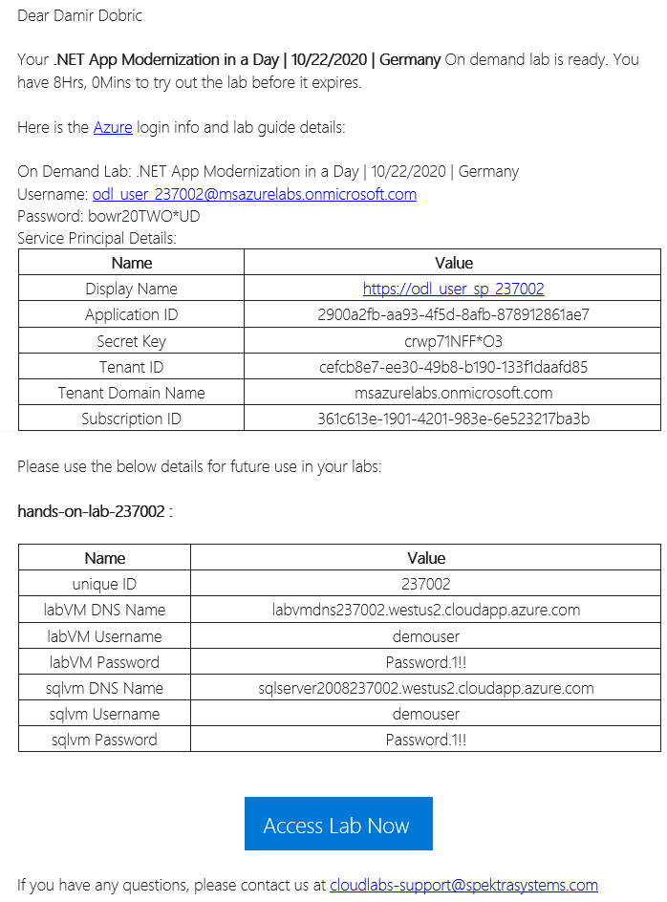
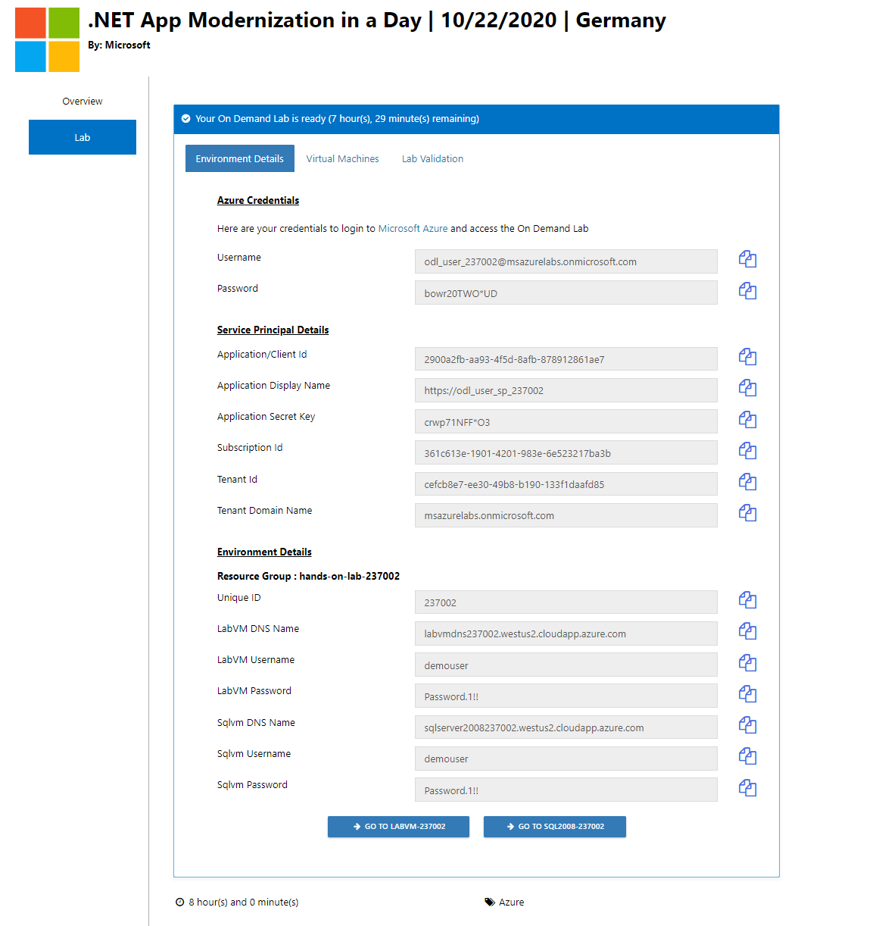
Step ZERO – Use MS Lab Environment
Sign up https://bit.ly/38W4nHz Activation Code: ACTIVATE10093
Wait on Email
Login to portal
https://portal.azure.com
Notes:
https://bit.ly/38kUqmP
Activation Code: ACTIVATE9775
https://portal.azure.com

Slide 12

Customer situation
Contoso, Ltd. provides a full range of long-term insurance services to help underinsured people.
They are trying to cope with being overloaded due to faster-than-expected growth.
Notes:
Contoso Ltd. is a new company in a very old business. Founded in Auckland, New Zealand, in 2005, by senior life insurance executives, the ambitious new company provides a full range of long-term insurance services to help people who are underinsured.
Almost from the start, the company grew far faster than anticipated. An avalanche of business meant that the original processes created to manage policy documentation became overloaded. Employees struggled to cope, even as the headcount rose from five to 110 during the first year.

Slide 13

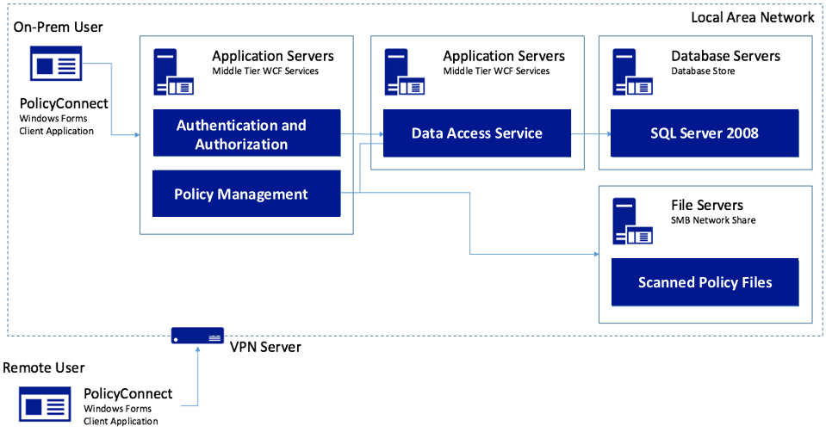
Customer situation
Contoso, Ltd. created a custom Windows Forms app called PolicyConnect for their employees to manage policy holder information.
Their data is stored in a SQL Server 2008 database, and a file server on their local area network.
Notes:
Contoso Ltd. implemented PolicyConnect, a custom Windows Forms application used by their staff to input key metadata that includes policy holder information such as insured amount, beneficiary, policy type, and any deductible and out of pocket requirements.
Contoso employees access this application which ultimately stores its data in a SQL Server 2008 database, and a file server on their local area network.

Slide 14



Customer situation
Employees rely on email as a workflow engine for document management tasks.
Would like options to gain insights without requiring custom development each time.
Wants to make policy holder system available through web and mobile applications without VPN.
Notes:
Contoso employees rely on email as a workflow engine relative to the document management tasks. They are using Office 365.
Executive leadership have frequent challenges in gauging productivity and throughput given the manual workflow—they feel that are blocked in quickly getting to the insights they need because each new question seems to need more custom development.
Wants to make their policy holder system available to its employees and brokers via web and mobile applications without requiring VPN, and store policies in cloud storage for retrieval via the new apps.
They would like to migrate their SQL Server based database to SQL Database

Slide 15




Customer situation
We would like to make sure our database isn’t overtaxed, show a dashboard with user statistics, allow non-developers in other departments to make mobile apps, and improve security by protecting application secrets.
Can you help us do this?
Notes:
Want to ensure they employ best practices for mitigating the impact of repeated querying of the database
Looking to implement a scoreboard of sorts that tracks the most active users in a 24-hour period, as well as approximate the number of operations that user performed with the system in perpetuity
Want to make sure they have a streamlined way for internal departments to quickly build their own apps to automate time saving micro-processes without having to involve the PolicyConnect development team or ideally, even developers
Improve security by externalizing secrets such as connection strings from the web apps and APIs, and storing them in an encrypted location accessible only to authorized services
Contoso has multiple development teams and is concerned about duplication of effort and change management as they move more business logic to APIs. They also are considering opening a subset of APIs to a network of affiliated partners.

Slide 16






Customer needs
Modernize our architecture
Go mobile
Enable non-developer employees to create apps
Improve management of app secrets
Add cognitive search
Reduce server management tasks
Migrate to fully-managed SQL database service
Add caching to our solution

Slide 17

Customer objections
How can we automate our processes?
Will Power Automate (aka Microsoft Flow) replace Logic Apps?
Is there really a way to securely store application secrets in the cloud?
We won’t have all of the SQL features available to us in the cloud.
Our API inventory will grow, and we are concerned about how to best manage that.
Wants to understand how choose correct .NET framework

Slide 18
Step 1: Review the customer case study
https://github.com/daenetCorporation/MCW-App-modernization/blob/master/Whiteboard%20design%20session/WDS%20student%20guide%20-%20App%20modernization.md
Outcome
Analyze your customer needs.
Timeframe
15 minutes
Notes:
https://github.com/daenetCorporation/MCW-App-modernization/blob/master/Whiteboard%20design%20session/WDS%20student%20guide%20-%20App%20modernization.md
Trainer Guide: https://github.com/microsoft/MCW-App-modernization/blob/master/Whiteboard%20design%20session/WDS%20trainer%20guide%20-%20App%20modernization.md

Slide 19
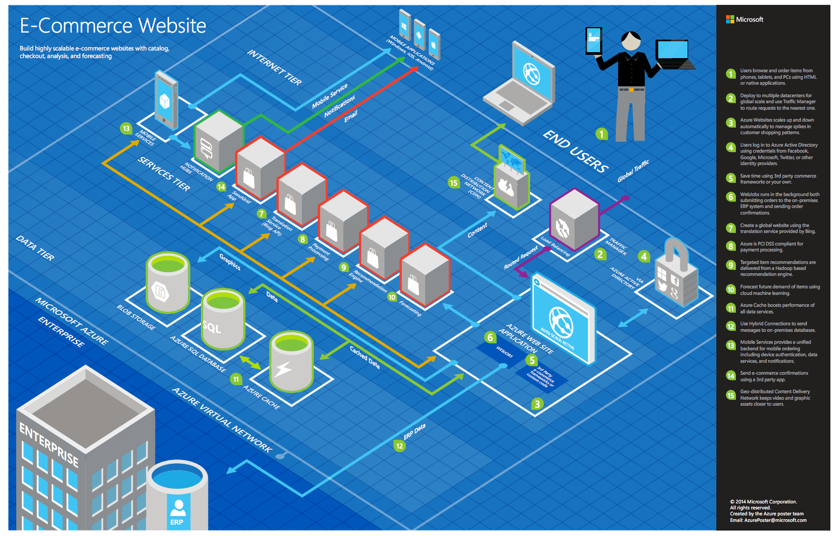
Common scenarios
Notes:
This is a diagram of a common architecture for this type of scenario, that you can draw inspiration from. You will find this diagram within the learner guide.

Slide 20
Step 2: Design the solution
Outcome
Design a solution and prepare to present the solution to the target customer audience in a 15-minute chalk-talk format.
Timeframe
60 minutes
Business needs (10 minutes) | Respond to questions outlined in your guide and list the answers on a flipchart.
Design (35 minutes) | Design a solution for as many of the stated requirements as time allows. Show the solution on a flipchart.
Prepare (15 minutes) | Identify any customer needs that are not addressed with the proposed solution. Identify the benefits of your solution. Determine how you will respond to the customer’s objections. Prepare for a 15-minute presentation to the customer.

Slide 21
Step 3: Present the solution
Outcome
Present a solution to the target customer in a 15-minute chalk-talk format.
Timeframe
30 minutes (15 minutes for each team to present and receive feedback)
Directions
Pair with another table.
One table is the Microsoft team and the other table is the customer.
The Microsoft team presents their proposed solution to the customer.
The customer asks one of the objections from the list of objections in the case study.
The Microsoft team responds to the objection.
The customer team gives feedback to the Microsoft team.

Slide 22
Wrap-up
Outcome
Identify the preferred solution for the case study. Identify solutions designed by other teams.
Timeframe
15 minutes

Slide 23

Preferred target audience
Charlene Mathis, General Manager, Contoso Ltd
The primary audience is business and technology decision makers.
Usually we talk to the Infrastructure Managers who report into the CIOs, or to application sponsors (like a VP LOB, CMO) or to those that represent the Business Unit IT or developers that report into application sponsors.

Slide 24
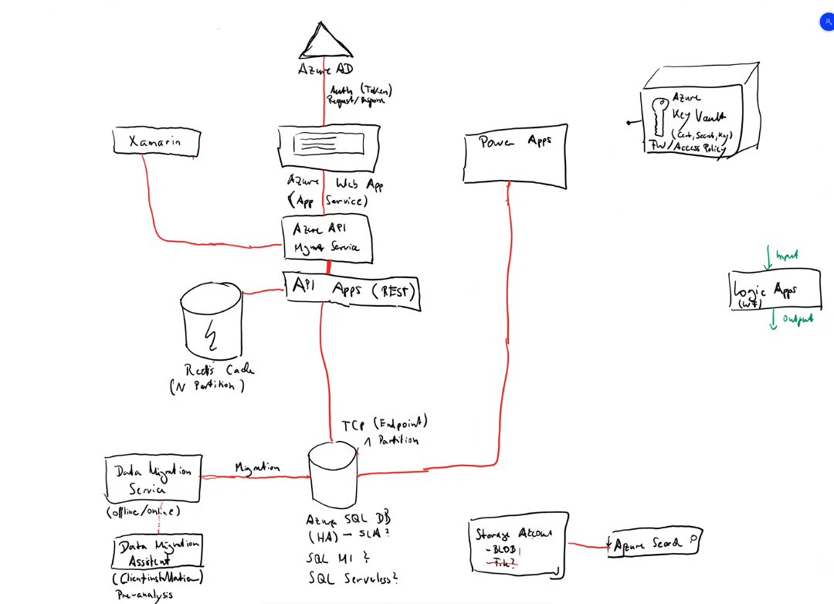

Slide 25
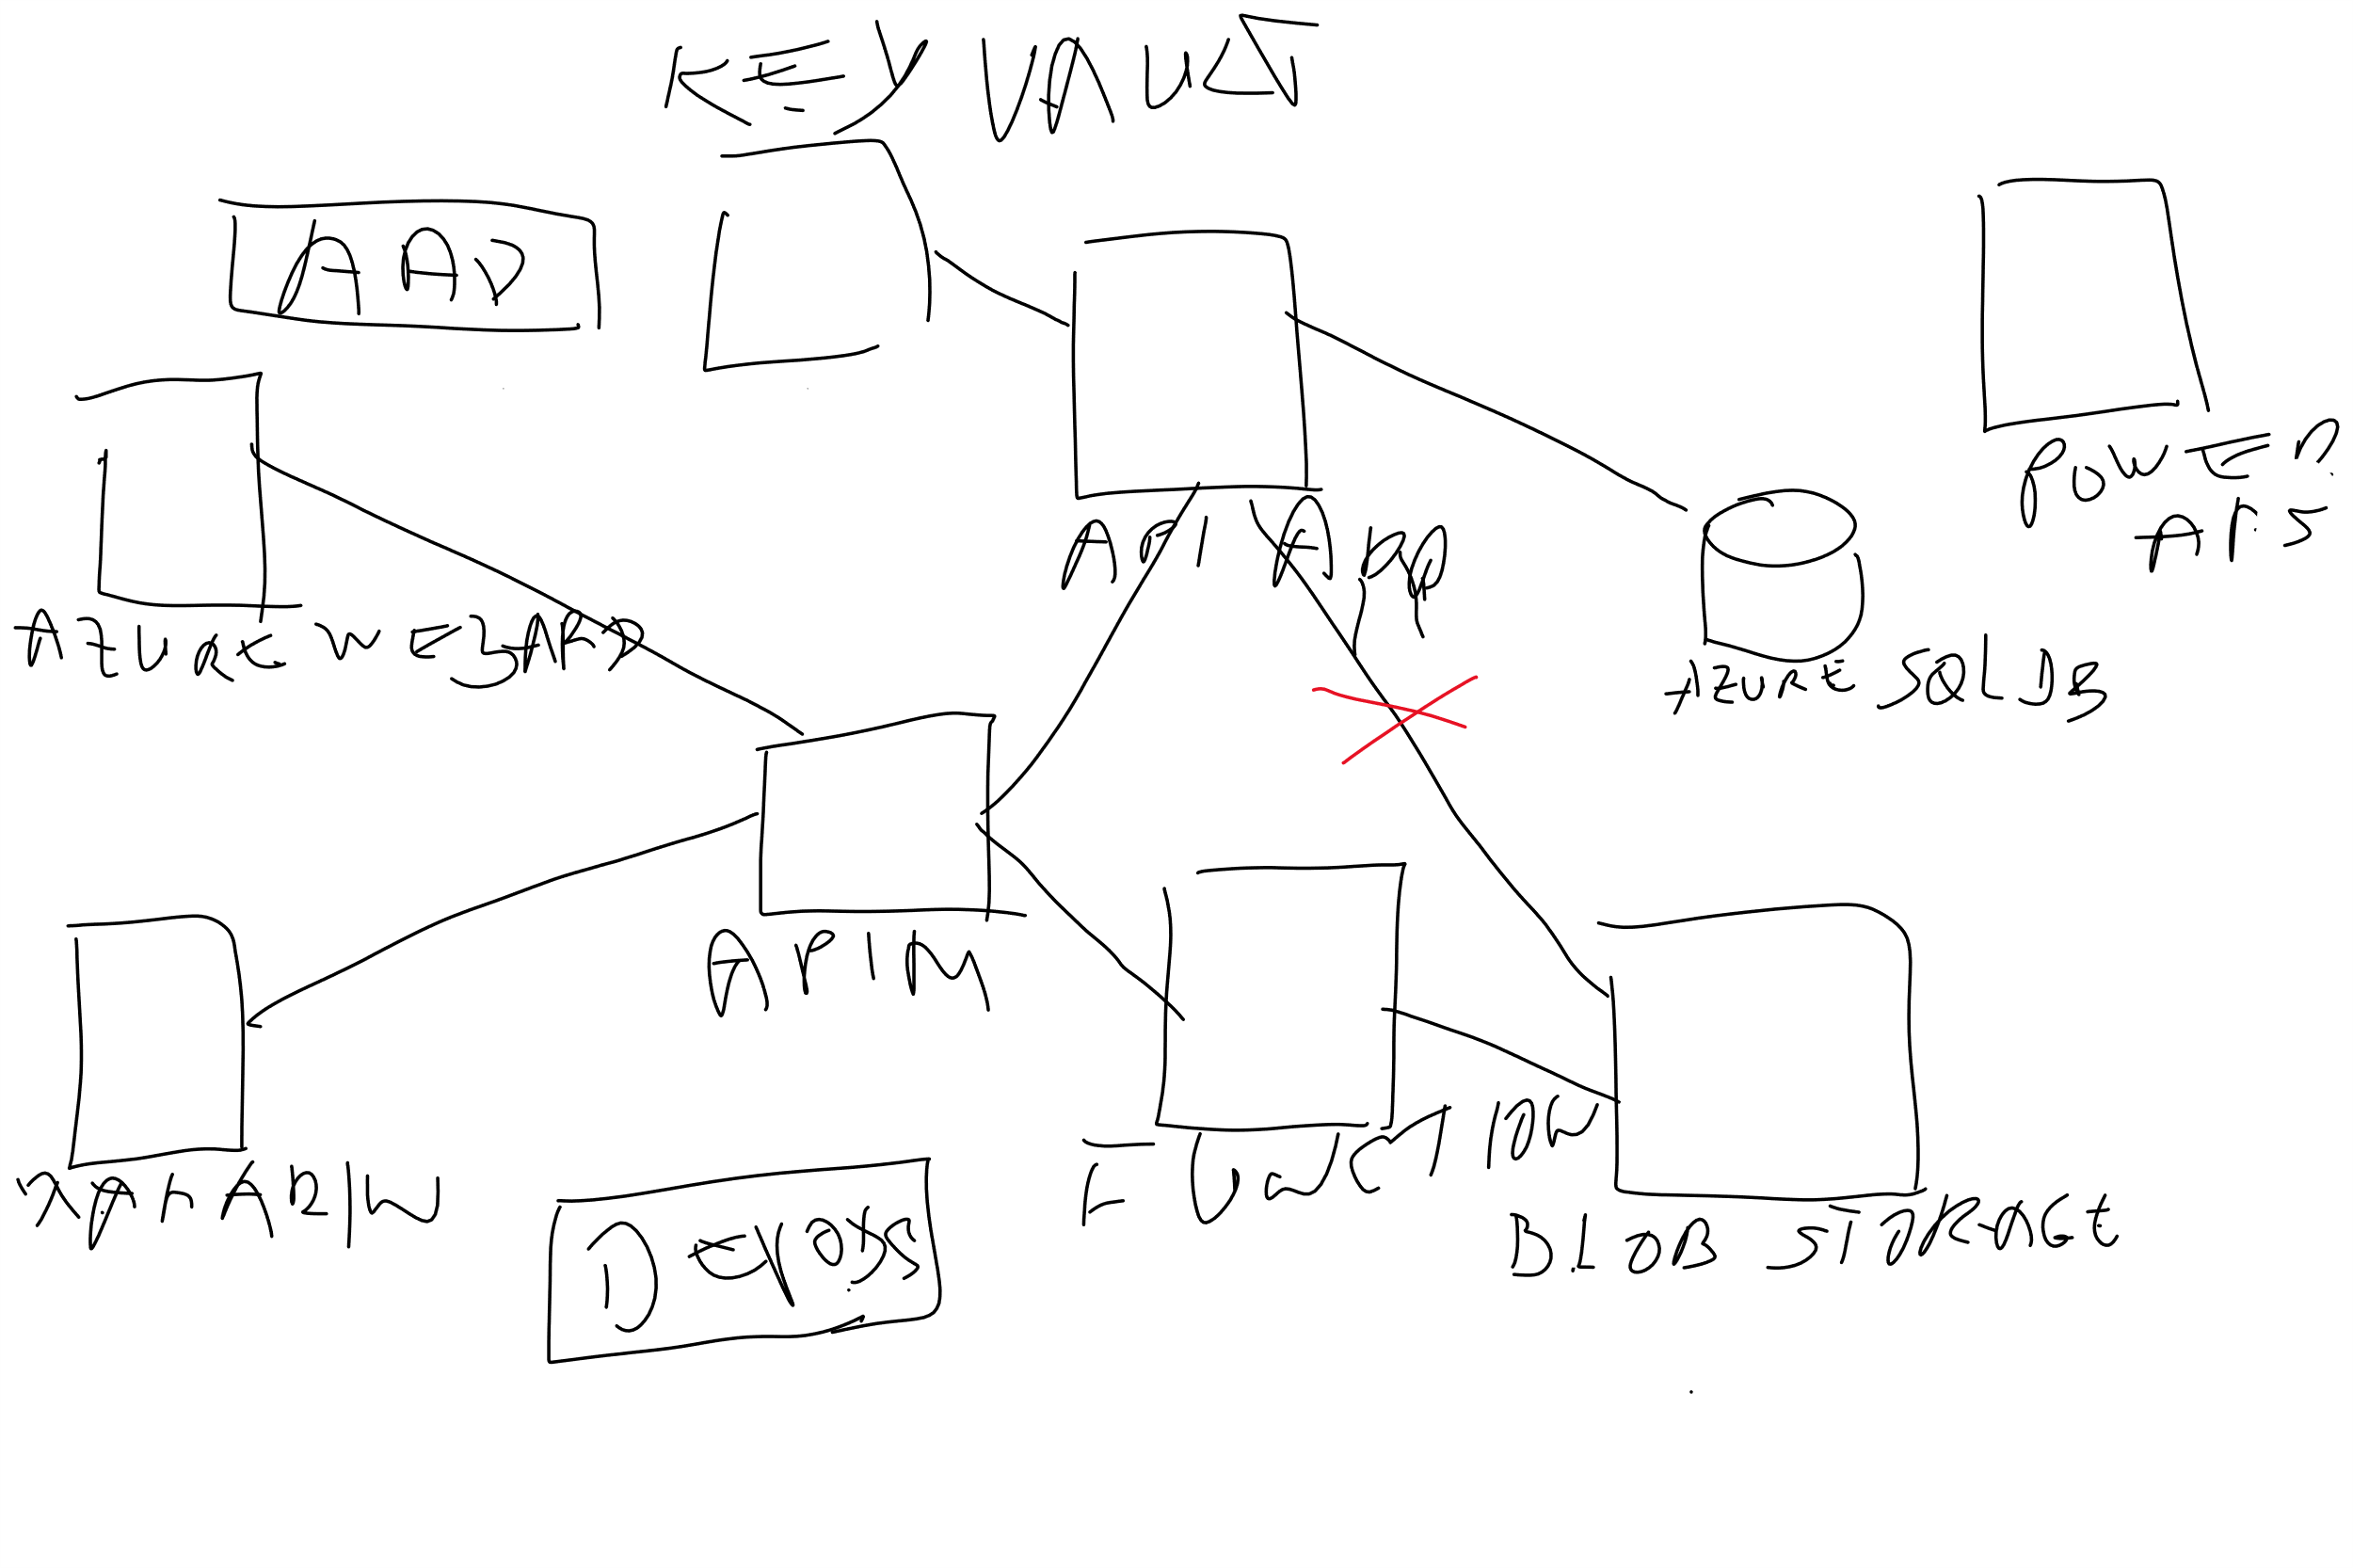

Slide 26
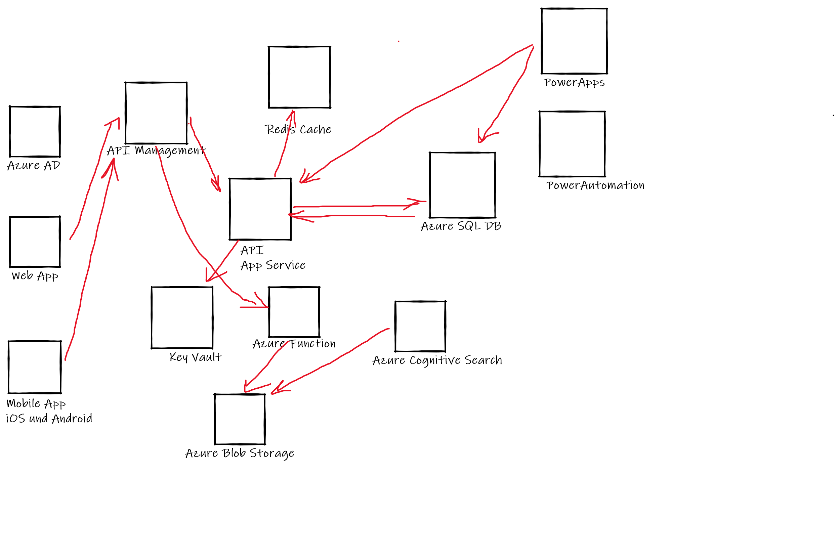

Slide 27
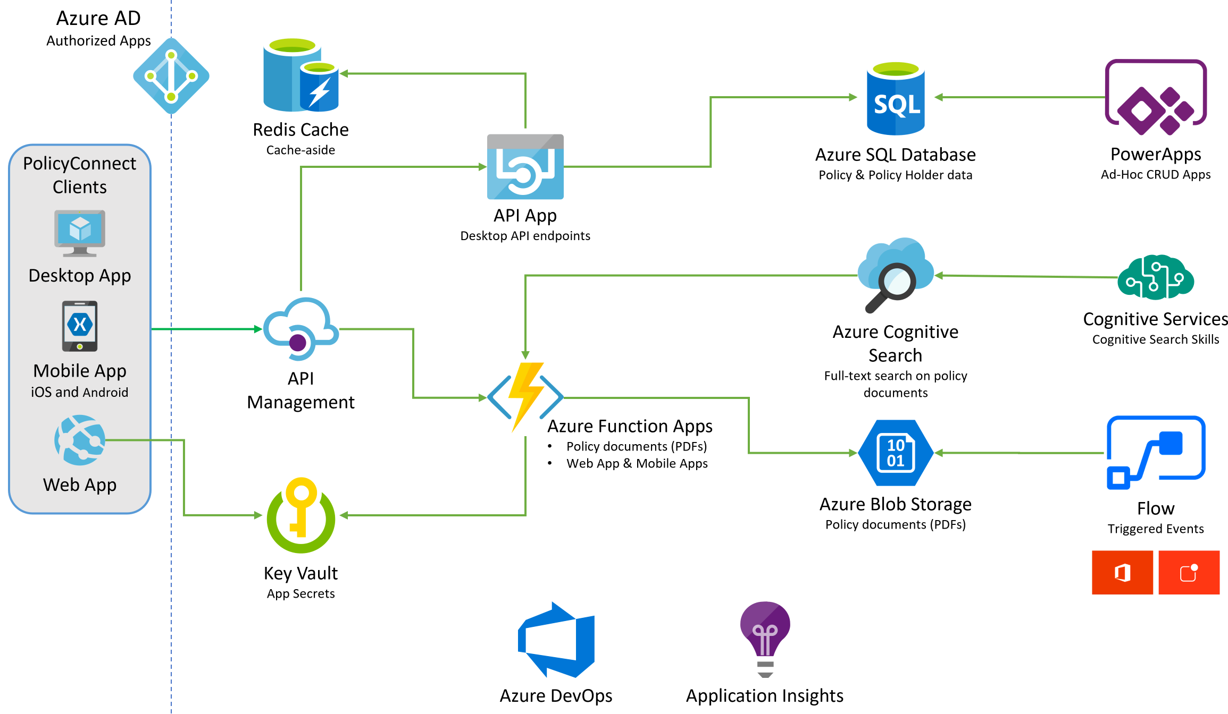
Preferred solution
Notes:
https://github.com/microsoft/MCW-App-modernization/blob/master/Whiteboard%20design%20session/WDS%20trainer%20guide%20-%20App%20modernization.md#preferred-solution The solution begins with migrating Contoso's SQL Server 2008 R2 database to Azure SQL Database using the Azure Database Migration Service. After performing an assessment using the Data Migration Assistant, Contoso was able to determine that there were no compatibility issues or unsupported features to prevent them from migrating into a fully-managed SQL database service in Azure. Next, the web and API apps are migrated into Azure App Services. In addition, mobile apps, built for Android and iOS using Xamarin, are created to provide access to PolicyConnect. The website, hosted in a Web App, provides the user interface for browser-based clients, whereas the Xamarin Forms-based apps provide the UI to mobile devices. Both the mobile app and website rely on web services hosted in a Function App, which sits behind API Management. An API App is also deployed to host APIs for the legacy Windows Forms desktop application. Light-weight, serverless APIs are provided by Azure Functions and Azure Functions Proxies to provide access to the database and policy documents stored in Blob Storage. Azure API Management is used to create an API Store for development teams and affiliated partners. Sensitive configuration data, like connection strings, are stored in Key Vault and accessed from the APIs or Web App on demand so that these settings never live in their file system. The API App uses the Azure Redis Cache to implement the cache aside pattern, caching data as it is retrieved from SQL Database. A full-text cognitive search pipeline is used to index policy documents in Blob Storage. Cognitive Services are used to enable search index enrichment using cognitive skills in Azure Cognitive Search. PowerApps enable authorized business users to build mobile and web create, read, update, delete (CRUD) applications that interact with SQL Database and Azure Storage, while Microsoft Flow enables them to orchestrations between services such as Office 365 email and services for sending mobile notifications. These orchestrations can be used independently of PowerApps or invoked by PowerApps to provide additional logic. The solution uses user and application identities maintained in Azure AD.

Slide 28
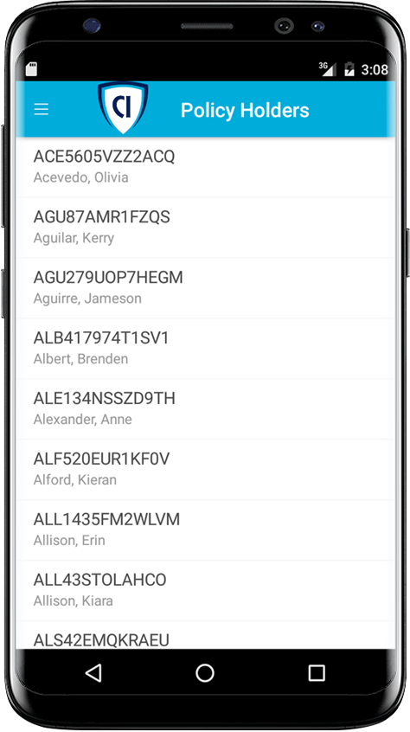
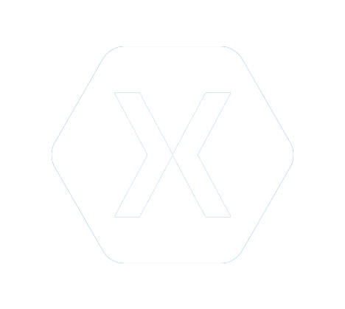


Preferred solution - 2
Mobile and Web Applications
Build mobile with Xamarin
Use an API App for the back-end
Host web site with a Web App
Use Azure Functions Proxies
Notes:
How should Contoso implement the PolicyConnect mobile app?
- Utilize Xamarin within Visual Studio
What Azure service would host the services supporting the mobile app backend? Would you suggest a Mobile App or an API App? Why?
- In this scenario, either one would work because API Apps and Mobile Apps expose the same functionality that Contoso needs to support the Web App and the APIs that are behind the Web App and the Xamarin mobile application.
What Azure service would host the web site?
- A Web App
What Azure service would provide a light weight, serverless API solution for retrieving policy documents from Azure blob storage?
- Azure Functions Proxies provide an easy way to create serverless APIs, providing a way to break large APIs into multiple function apps (as in a microservices architecture), while still presenting a single API surface for clients.

Slide 29
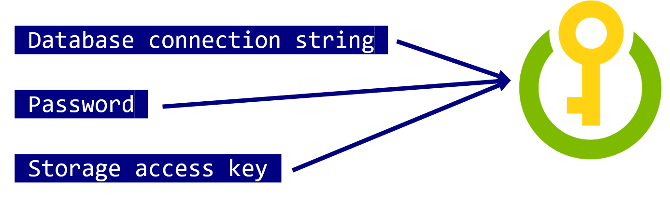
Preferred solution - 3
Mobile and Web Applications
Use Key Vault to store sensitive application secrets like database connection strings.
Notes:
How would you secure sensitive information used by the web site and APIs?
- Rather than storing sensitive application secrets like credentials and database connection strings in the web.config of the Web and API Apps, Contoso should use Key Vault to store these secrets

Slide 30
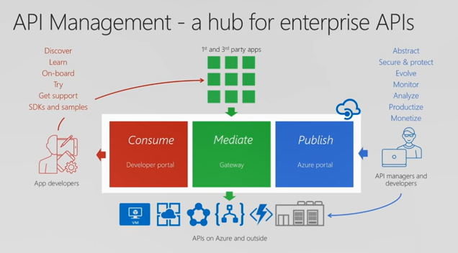

Preferred solution - 4
API Management
Contoso should use Azure API Management now to put together a proof of concept solution.
Azure API Management
Notes:
What recommendations can you make to help Contoso manage its API inventory as it grows in the future? Are there services in Azure that can provide a proof of concept *API Store* experience now and serve as path to development in the future?- Azure API Management has features to help Contoso quickly build and scale an API ecosystem and grow into the future. APIs can be organized into Product groups to provide organization and AAD integration comes out of the box. It will be relatively easy to develop new customer channels for affiliated partners and provide controlled discoverability and lifecycle management to development teams.

Slide 31
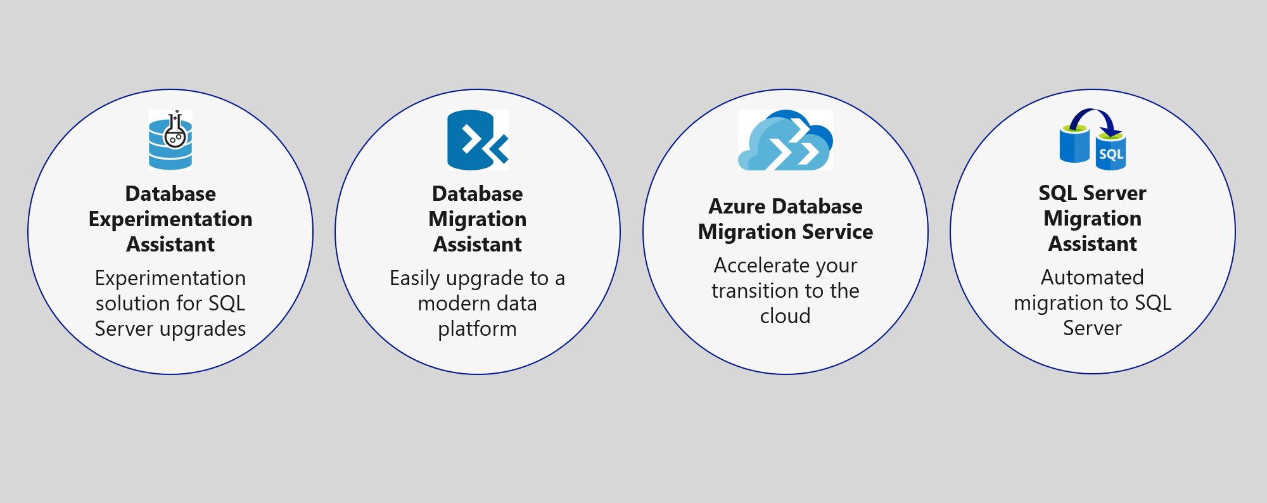
Preferred solution - 5
Data Management
Migrate database to Azure SQL using Database Migration Service

Slide 32
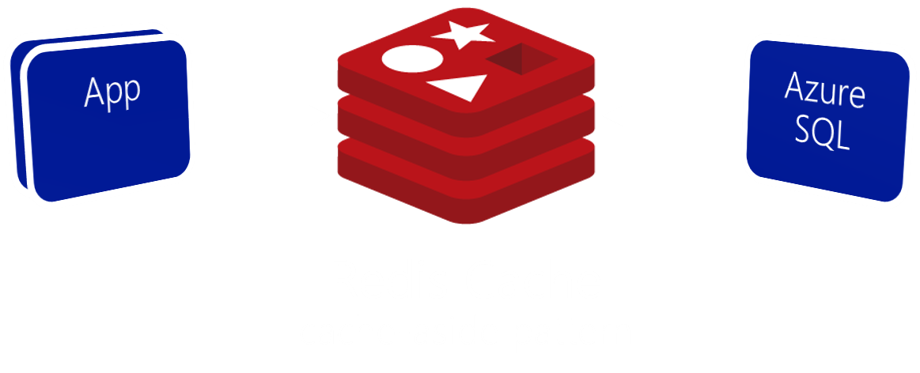
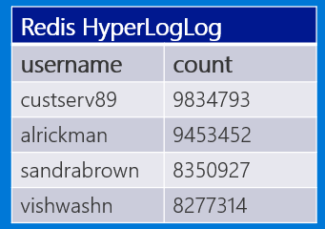
Preferred solution - 6
Data management
Use Azure Redis Cache to reduce load on database and implement scoreboards.
Scoreboard using HyperLogLog
Notes:
What patterns and services would you use to reduce load on the database? Implement the scoreboards?
- Use Azure Redis Cache and the cache-aside pattern.
- Check Azure Redis Cache is first on data requests. Return cached copy if exists, fetch from SQL Database if not, then save to Redis Cache.
- Scoreboards can also be implemented with Azure Redis Cache due to support for fast atomic incrementing of the values for any given string key (e.g., the key would be the username, the value the count). To reduce memory requirements for very large counts, use Redis’ HyperLogLog to store the counted value for each user key.
----------------------------------------------------------------------------------------
- In this approach, as data items are requested, the Azure Redis Cache is first checked to see if it exists there (if it is, then the cached copy is returned). Failing that, the application makes a request directly against SQL Database, but while returning the result to the client it also adds the data item into the Redis Cache.
- Scoreboards can be implemented effectively using Azure Redis Cache because of its support for fast atomic incrementing of the values for any given string key (e.g., the key would be the username, the value the count). To reduce memory requirements for very large counts (such as is possible collecting transaction counts per user in perpetuity), they could use Redis’ HyperLogLog to store the counted value for each user key. The HyperLogLog approximates the cardinality of a set the approximates the count of the number of unique items added (with an error rate less than 1%), and uses a fixed size of 12KB.

Slide 33
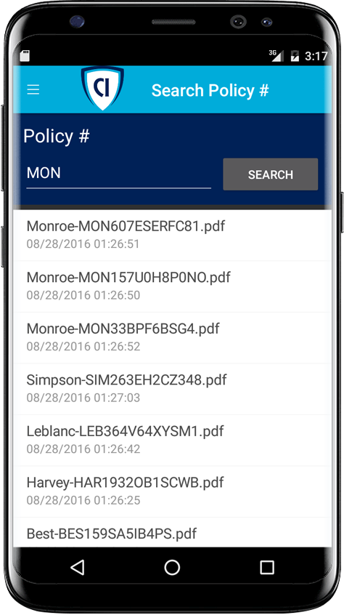

Preferred solution - 7
Search
Enable full-text search of policy documents with Azure Cognitive Search.
Azure Cognitive Search + Indexer for Azure Storage blobs
Notes:
Given their requirements, how would you enable full text search on the stored policy documents?
- Use Azure Cognitive Search and the Indexer for Azure Storage blobs.
- For files stored in Azure Storage Blobs, this indexer will full-text index PDFs, Microsoft Office Documents (DOCX, DOC, XLSX, XLS, PPTX, PPT and MSG), HTML, XML, ZIP, EML, JSON, and plain text files. They could then use the Azure Cognitive Search .NET SDK from the API App to kick off searches.

Slide 34
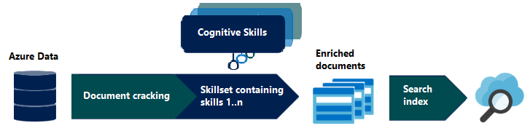
Preferred solution - 8
Search
Enrich search index with Cognitive Search

Slide 35

Preferred solution - 9
Search
Custom cognitive skills
Azure Cognitive Search + Functions

Slide 36

Preferred solution - 10
Extensibility
Enable business users to create their own internal mobile apps using PowerApps.
They can use Microsoft Flow to create ad-hoc automated processes.
Notes:
How would you enable their business users to create their own internal mobile apps that help them streamline their processes without the time and resource investment required for full scale mobile apps?
- PowerApps would enable business users at Contoso to create their own web and mobile apps that support CRUD functionality against data in SQL DB and Azure Storage Blobs.
- Microsoft Flow, which integrates with PowerApps but can also be used stand-alone, would enable them to create automated processes in ad-hoc fashion. Business users could create these for their own use or share them back with the rest of the organization.

Slide 37
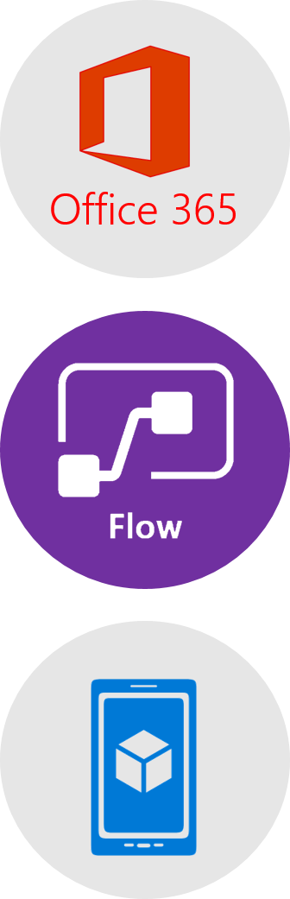
Preferred solution – 11
Extensibility
Business users can create an automated email workflow with Microsoft Flow in 3 easy steps:
Create a new flow that starts with Office 365, on new email with High priority.
Send a push notification action using subject and sender from email.
User would install Microsoft Flow app to receive notifications.
Notes:
This could be implemented with Microsoft Flow.
The business user would login to Microsoft Flow and create a new flow. It would begin with Office 365, on new email, where the priority flag is set to High.
Then a Push notification – send a push notification action would follow that can use the subject and sender of the email in the subject of the notification.
The user would save this flow. To receive notifications, the user would need to install the Microsoft Flow app on her mobile device.

Slide 38


Preferred objection handling
How can we automate our processes?
Will Microsoft Flow replace Logic Apps?
Is there really a way to securely store application secrets in the cloud?
How can we stay on top of a growing API ecosystem?
We won’t have all of the SQL features available to us in the cloud.
Which .NET framework should we choose?
Notes:
https://github.com/microsoft/MCW-App-modernization/blob/master/Whiteboard%20design%20session/WDS%20trainer%20guide%20-%20App%20modernization.md#checklist-of-preferred-objection-handling
* Microsoft Flow allows business users to automate their processes.
* Flow will not replace Logic Apps. Logic Apps represent an “advanced” version of Microsoft Flow, providing support for more developer centric tasks, such as integrating API Apps as custom actions, whereas Flow only provides pre-built actions.
* Azure Key Vault provides a mechanism to store secrets encrypted and securely stored within the confines of specialized hardware called Hardware Security Modules (HSM). * A proof of concept that demonstrates the capabilities of Azure API Management can be put together quickly and can easily be scaled up to create the API Store experience Contoso is looking for.
* It is likely that a feature that was previously built into SQL Server and used from applications directly now runs external to Azure SQL Database in the form of a separate Azure service. Examples include:
Linked servers- are not supported by SQL Server, but cross database read-only querying is possible using elastic database query.
Database Mail- which was used to send email directly from SQL Server is not supported, but there are multiple alternatives (such as using Office 365 and SendGrid) that applications can use to send emails.
SQL Server Agent Jobs- these background processes can usually be migrated to a Web Job (running within an App Service), Azure Functions, or to Cloud Service Worker Role.
Service Broker- numerous alternative messaging options exist in Azure, including Azure Storage Queues and Azure Service Bus Brokered Messaging.

Slide 39
Customer quote
“Microsoft has done a brilliant job with the technology they have put into the cloud. Our Azure-hosted applications are modifiable, interoperable, and secure. We could not be happier running PolicyConnect on Azure.”
Charlene Mathis, General Manager, Contoso, Ltd.

Slide 40
App modernization
Hand-On-Lab https://github.com/daenetCorporation/MCW-App-modernization/blob/master/Hands-on%20lab/HOL%20step-by-step%20-%20App%20modernization.md
Notes:
https://github.com/daenetCorporation/MCW-App-modernization/blob/master/Hands-on%20lab/HOL%20step-by-step%20-%20App%20modernization.md

Slide 41
All content is on GitHub
https://github.com/daenetCorporation/MCW-App-modernization
https://github.com/microsoft/MCW-App-modernization
Notes:
https://github.com/daenetCorporation/MCW-App-modernization

Slide 42

Survey
https://forms.office.com/Pages/ResponsePage.aspx?id=v4j5cvGGr0GRqy180BHbR4UXtppiuOFNvOnZh_G-wrFUOElGOFcyWFZXVzRISVVFRDhMTDQyOFNJQiQlQCN0PWcu
Workshop Engagement ID: HOL_Germany_2020-12-03_619

Slide 43
THANK YOU ☺
Damir Dobric
Lead Software Architect at daenet GmbH
Microsoft Regional Director
Azure Most Valuable Professional
Proctor:
Edin Mulic
Senior Software Architect at daenet

Slide 44
THANK YOU ☺
Edin Mulic
Senior Software Architect at daenet
Proctor:
Damir Dobric
Lead Software Architect at daenet GmbH
Microsoft Regional Director
Azure Most Valuable Professional
https://damirdobric.me/

Slide 45
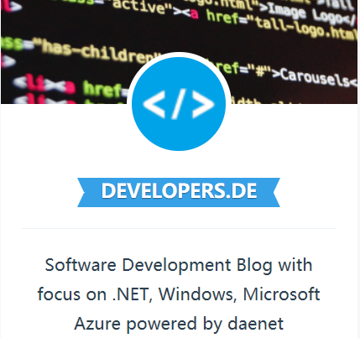

Besuchen Sie unser Azure Meetup www.meetup.com/Azure-Meetup-Frankfurt/
Besuchen Sie unseren Software Development Blog www.developers.de

